Slide 1

INTRODUCTION
ECOMMERCE-WEBSITE

Slide 2
ABOUT US
ASHIRWAAD JWELLERS
Welcome to Ashirwaad Jewellery, where tradition meets elegance. We craft exquisite gold jewellery that celebrates life’s cherished moments. Our collection blends timeless artistry with contemporary designs, offering everything from intricate traditional pieces to modern styles. Crafted with the finest gold, each piece symbolizes prosperity, love, and blessings. Whether for weddings, festivals, or everyday wear, Ashirwaad Jewellery ensures you shine with confidence. Experience trust, beauty, and heritage in every jewel.

Slide 3
CONTENTS
01
02
03
The e-commerce features on the home page
Technologies used.
Challenges and how you resolved them.

Slide 4
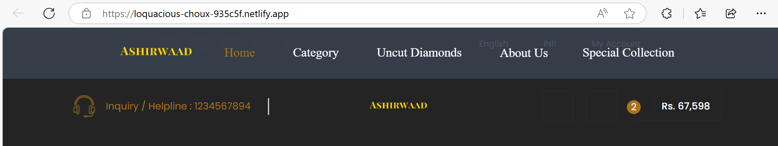
The e-commerce features on the home page
(A) LOGO BRANDING
LOFOe used as demonstrations.
Your Title Here
Presentation are communication tools that can be used as demontrations, lectures, reports, and more. it is mostly presented before an audience.

Slide 5
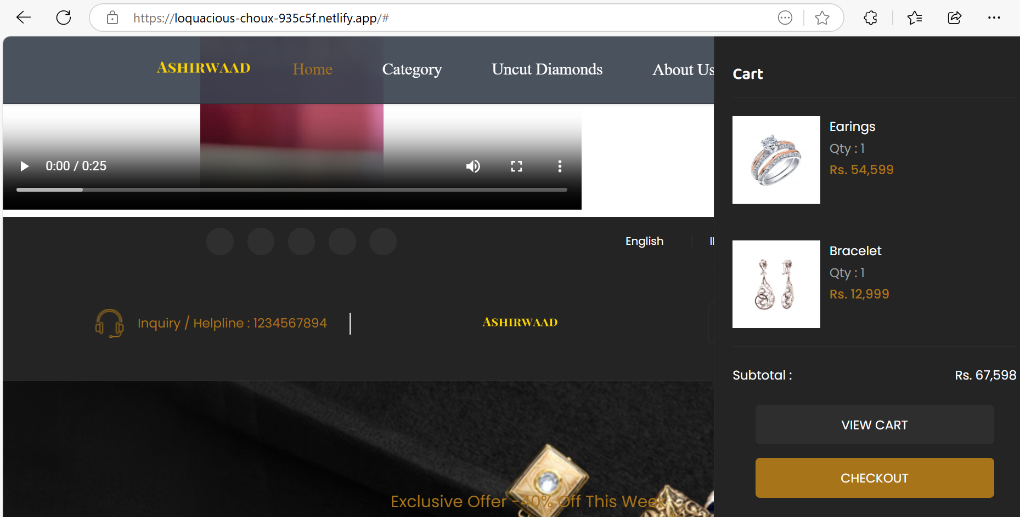
(B) NAVIGATION BAR
LOFOe used as demonstrations.
Your Title Here
Presentation are communication tools that can be used as demontrations, lectures, reports, and more. it is mostly presented before an audience.

Slide 6
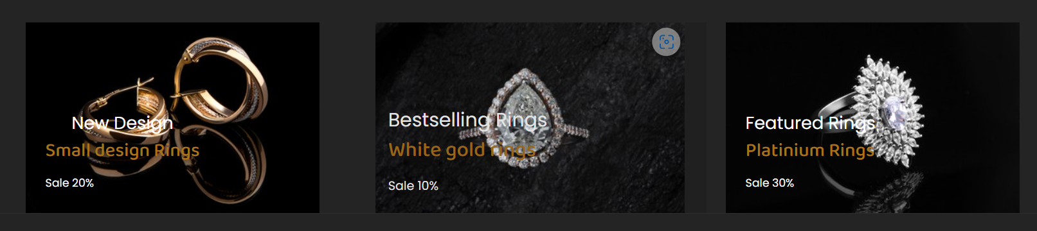
The Products showcase
1. TOP SALES
LOFOe used as demonstrations.
Your Title Here
Presentation are communication tools that can be used as demontrations, lectures, reports, and more. it is mostly presented before an audience.

Slide 7
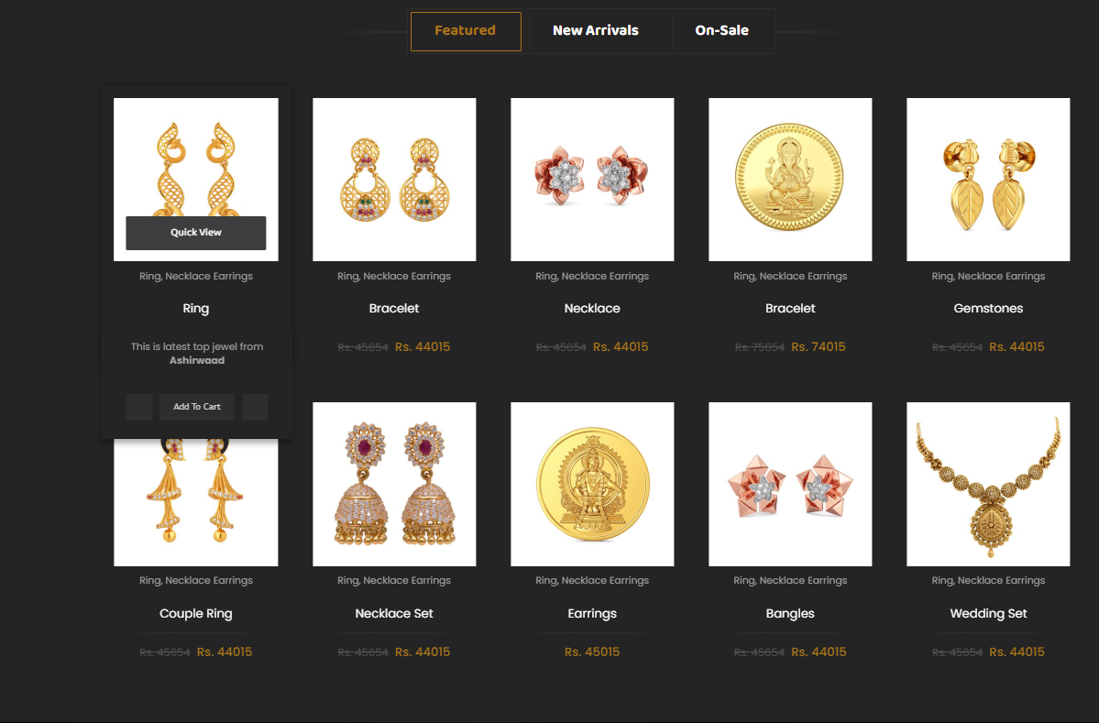
2. FEATURED PRODUCTS
LOFOe used as demonstrations.
Your Title Here
Presentation are communication tools that can be used as demontrations, lectures, reports, and more. it is mostly presented before an audience.

Slide 8
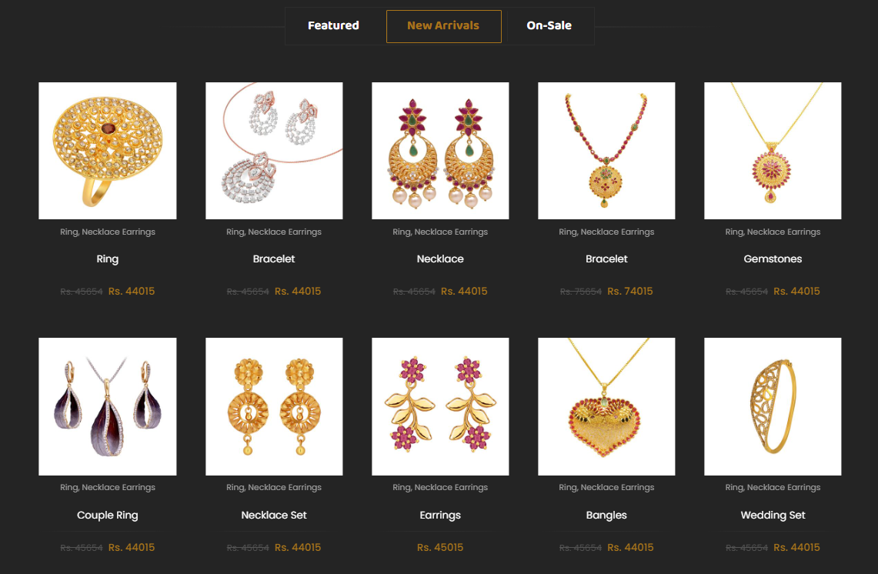
3. NEW ARRIVALS
LOFOe used as demonstrations.
Your Title Here
Presentation are communication tools that can be used as demontrations, lectures, reports, and more. it is mostly presented before an audience.

Slide 9
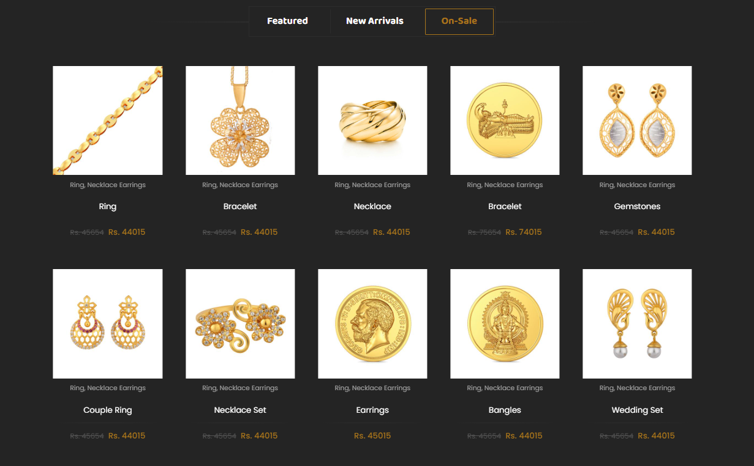
4. ON-SALE
LOFOe used as demonstrations.
Your Title Here
Presentation are communication tools that can be used as demontrations, lectures, reports, and more. it is mostly presented before an audience.

Slide 10
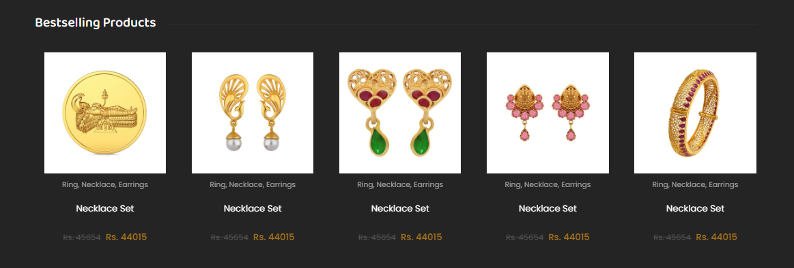
5. BEST SELLING PRODUCTS
LOFOe used as demonstrations.
Your Title Here
Presentation are communication tools that can be used as demontrations, lectures, reports, and more. it is mostly presented before an audience.

Slide 11
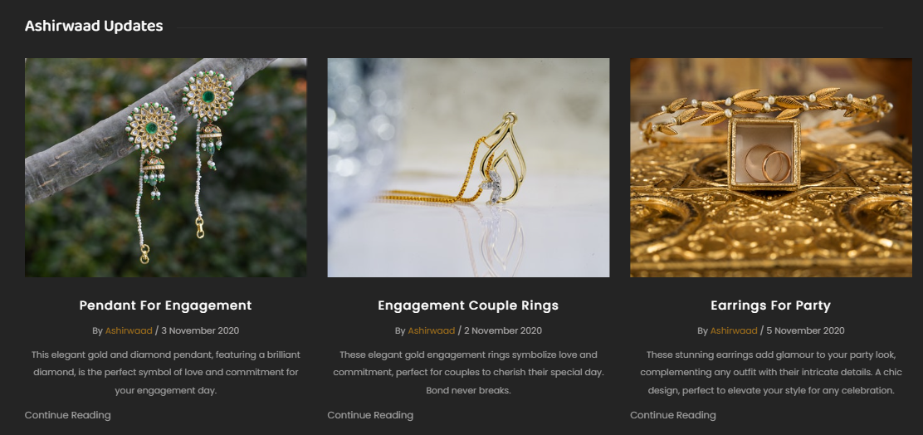
6. ASHIRWAAD UPDATES
LOFOe used as demonstrations.
Your Title Here
Presentation are communication tools that can be used as demontrations, lectures, reports, and more. it is mostly presented before an audience.

Slide 12
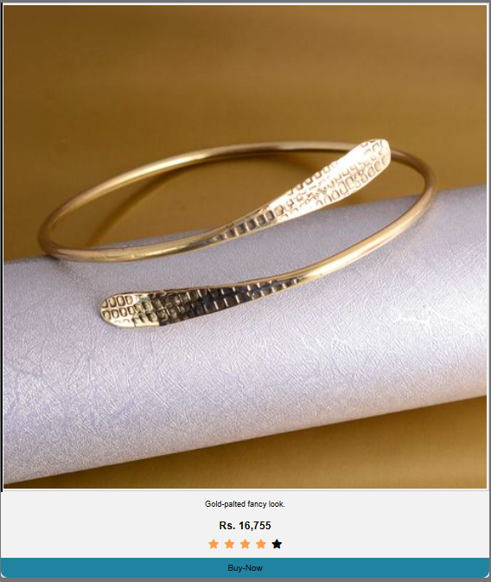
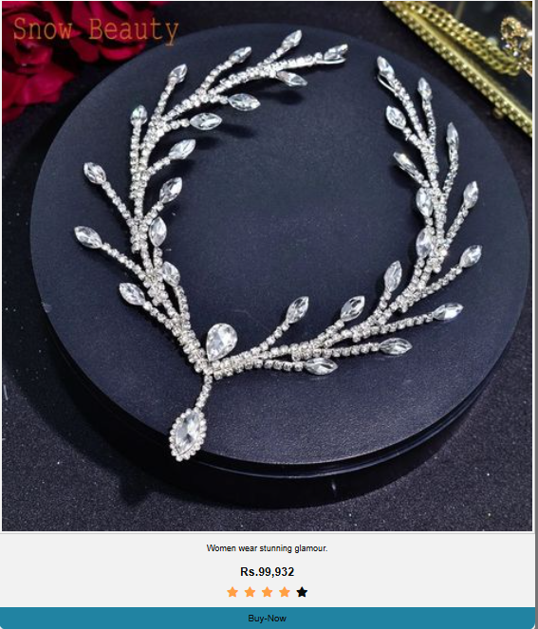
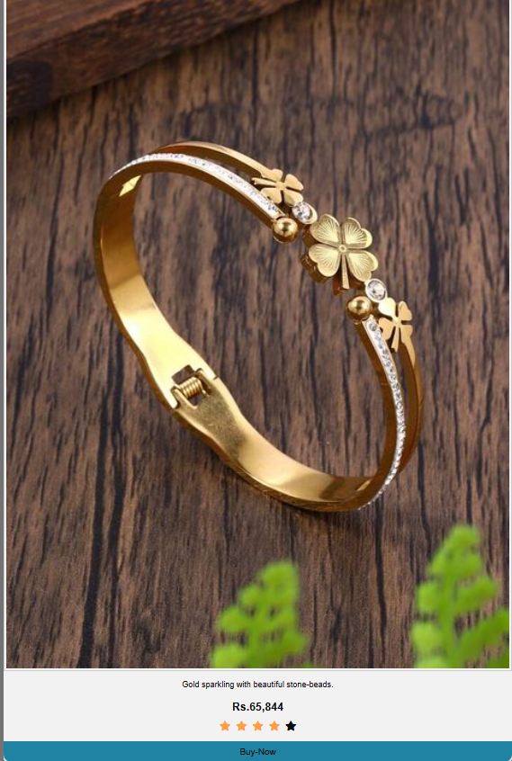
Jewellery Collections
LOFOe used as demonstrations.
Your Title Here
Presentation are communication tools that can be used as demontrations, lectures, reports, and more. it is mostly presented before an audience.

Slide 13
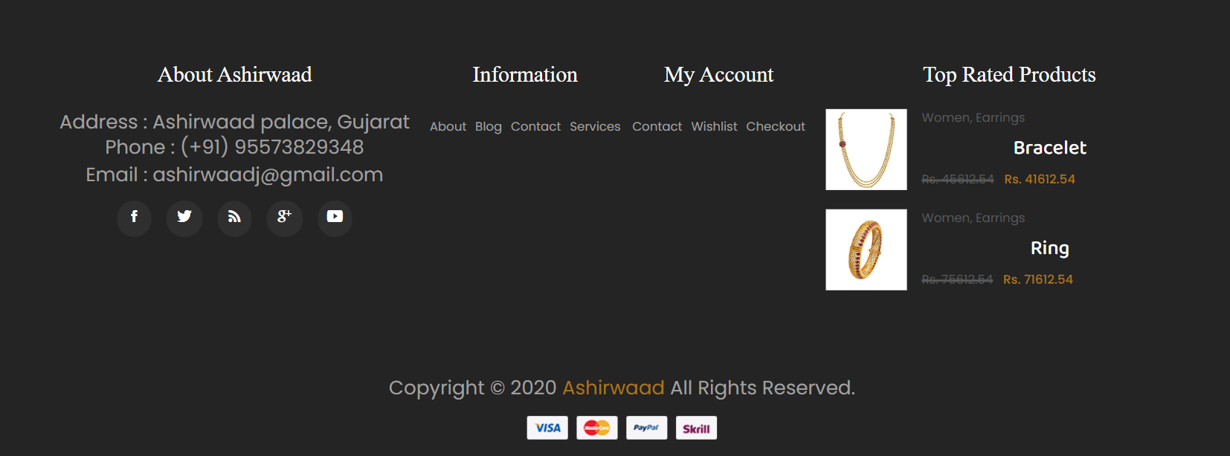
Footer Features
LOFOe used as demonstrations.
Your Title Here
Presentation are communication tools that can be used as demontrations, lectures, reports, and more. it is mostly presented before an audience.

Slide 14
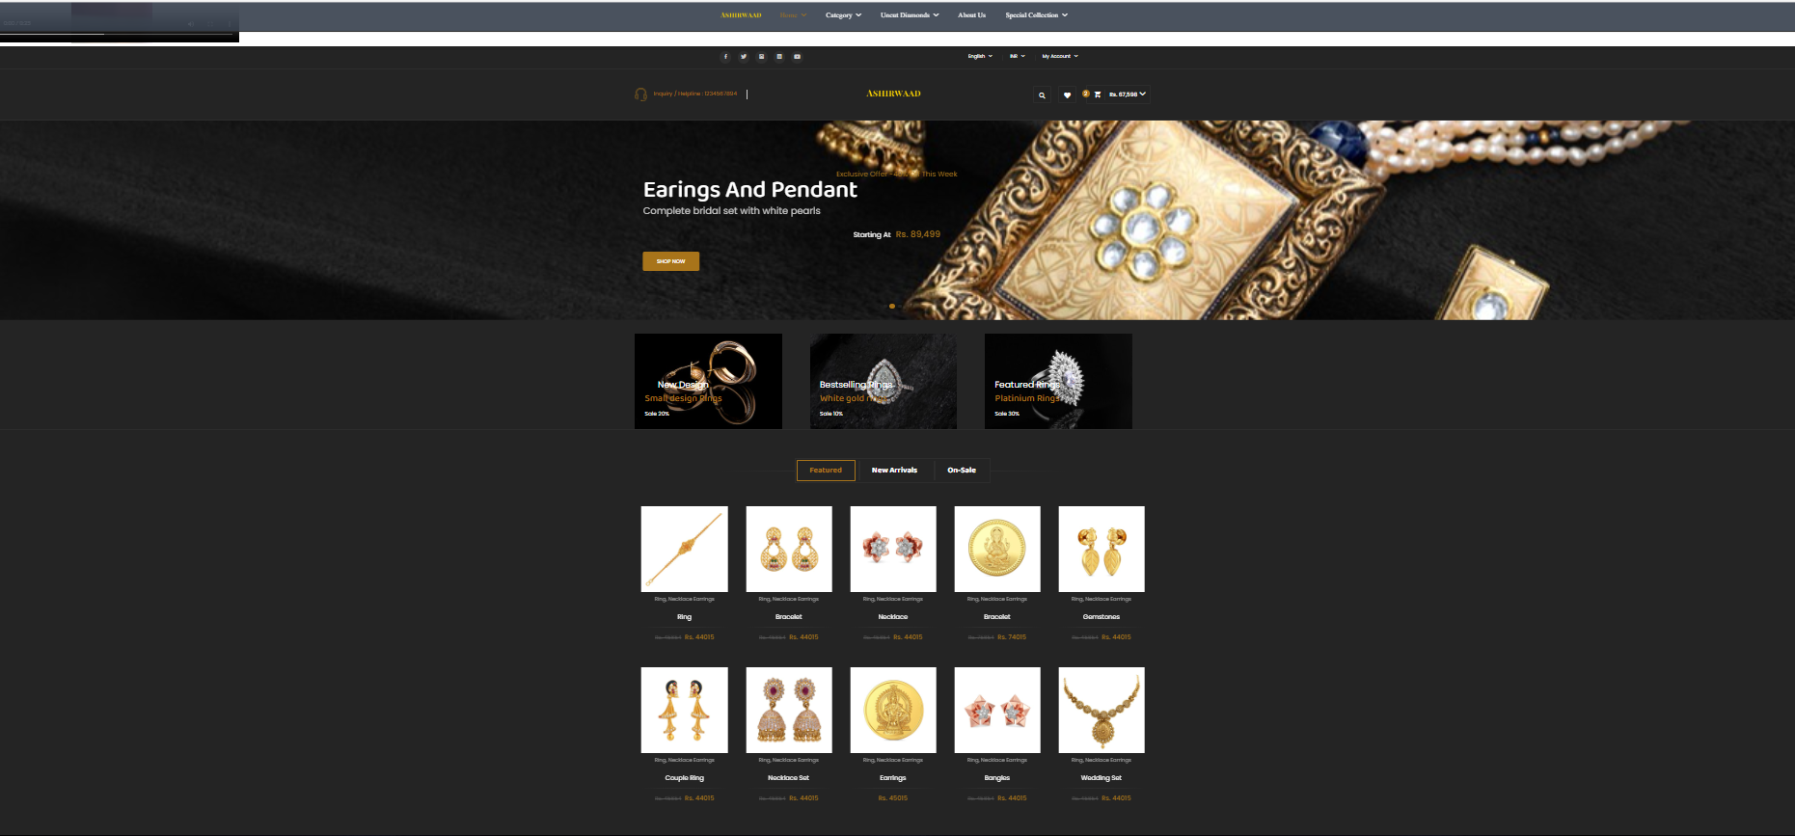
Responsive Design
(a). ON WINDOWSPAGE-LAPTOP
LOFe used as demonstrations.
Your Title Here
Presentation are communication tools that can be used as demontrations, lectures, reports, and more. it is mostly presented before an audience.

Slide 15
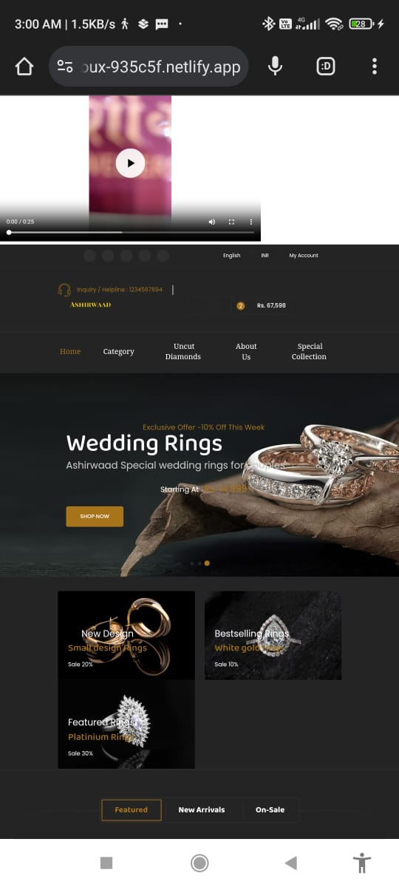
(b). MOBILE PAGE
LOFe used as demonstrations.
Your Title Here
Link is:-
https://loquacious-choux-935c5f.netlify.app/
Link is obtained
after deployed on
netlify app
Prsentation are communication tools that can be used as demontrations, lectures, reports, and more. it is mostly presented before an audience.

Slide 16
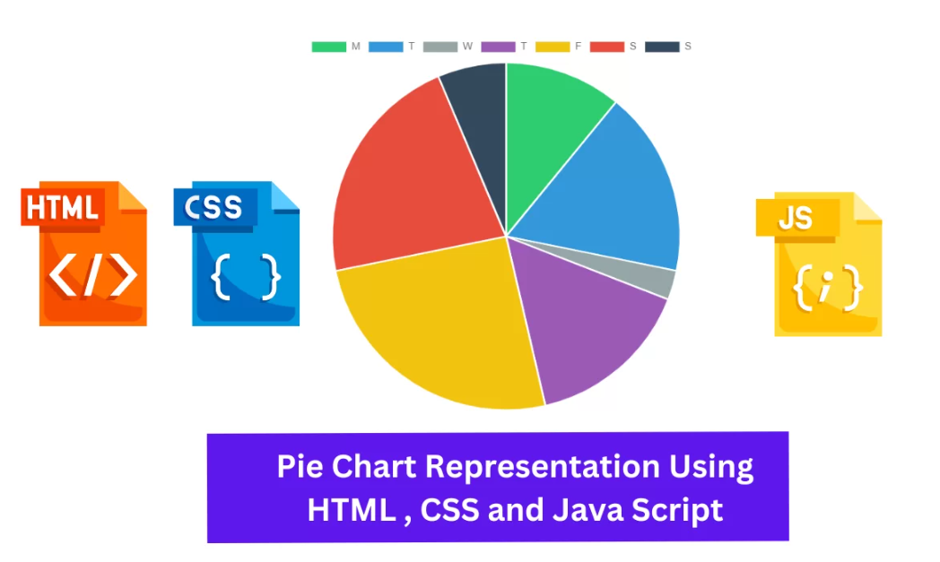
Technologies Used for E-Commerce Website Development
(i).
LOFe used as demonstrations.
Your Title Here
Presentation are communication tools that can be used as demontrations, lectures, reports, and more. it is mostly presented before an audience.

Slide 17
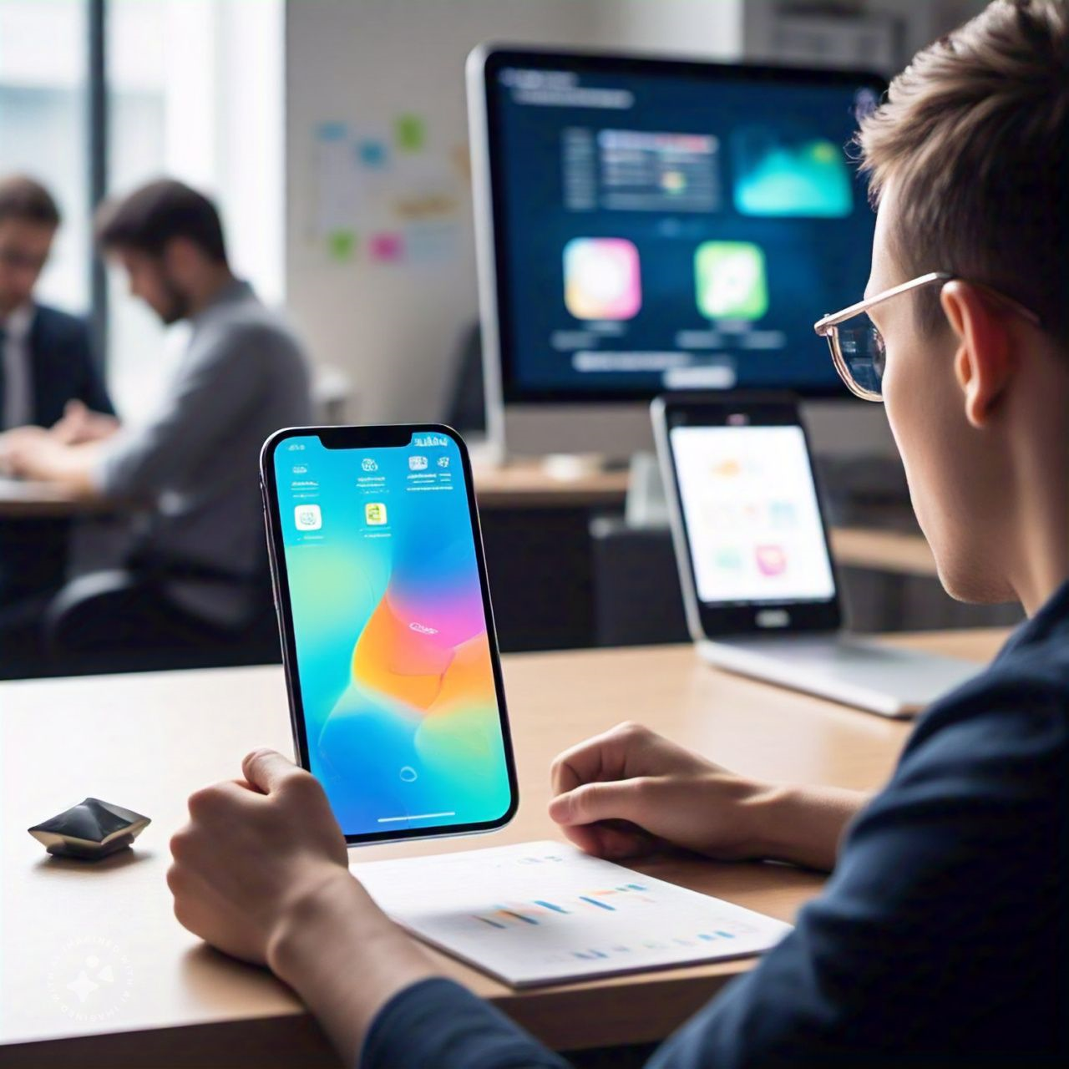
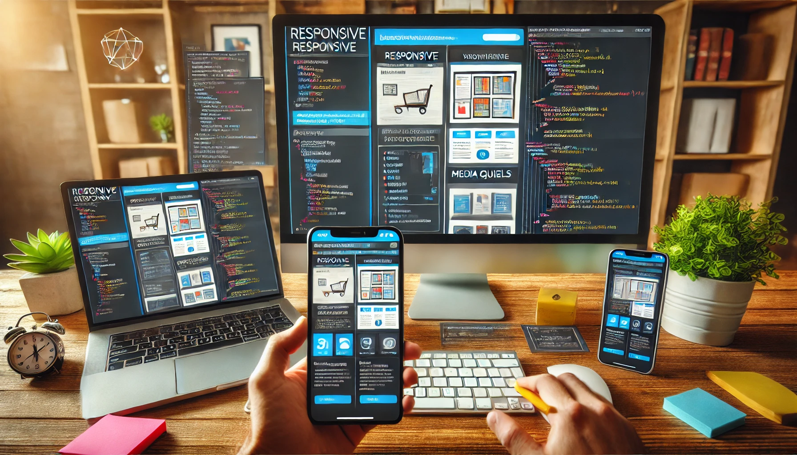
03. Challenges Resolved
1. Challenge: Ensuring Responsiveness Across Devices
Issue: Making sure the website looked good on mobile, tablet, and desktop was challenging.
Solution: Used Bootstrap or Tailwind CSS to ensure the layout was responsive. Applied media queries to adjust styles based on device screen sizes. show or give me its image

Slide 18

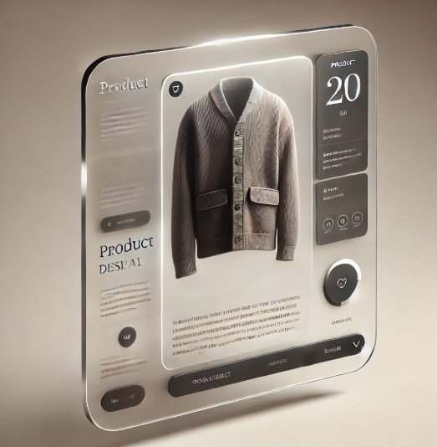
03. Challenges Resolved
2. Challenge: Creating Interactive Hover Effects for Product Images show or give me its image
Issue: Adding hover effects to product images that were both smooth and functional.
Solution: Utilized CSS hover effects for smooth transitions.
Tested the effects on different devices to ensure proper functionality.

Slide 19
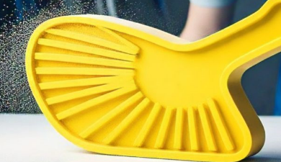
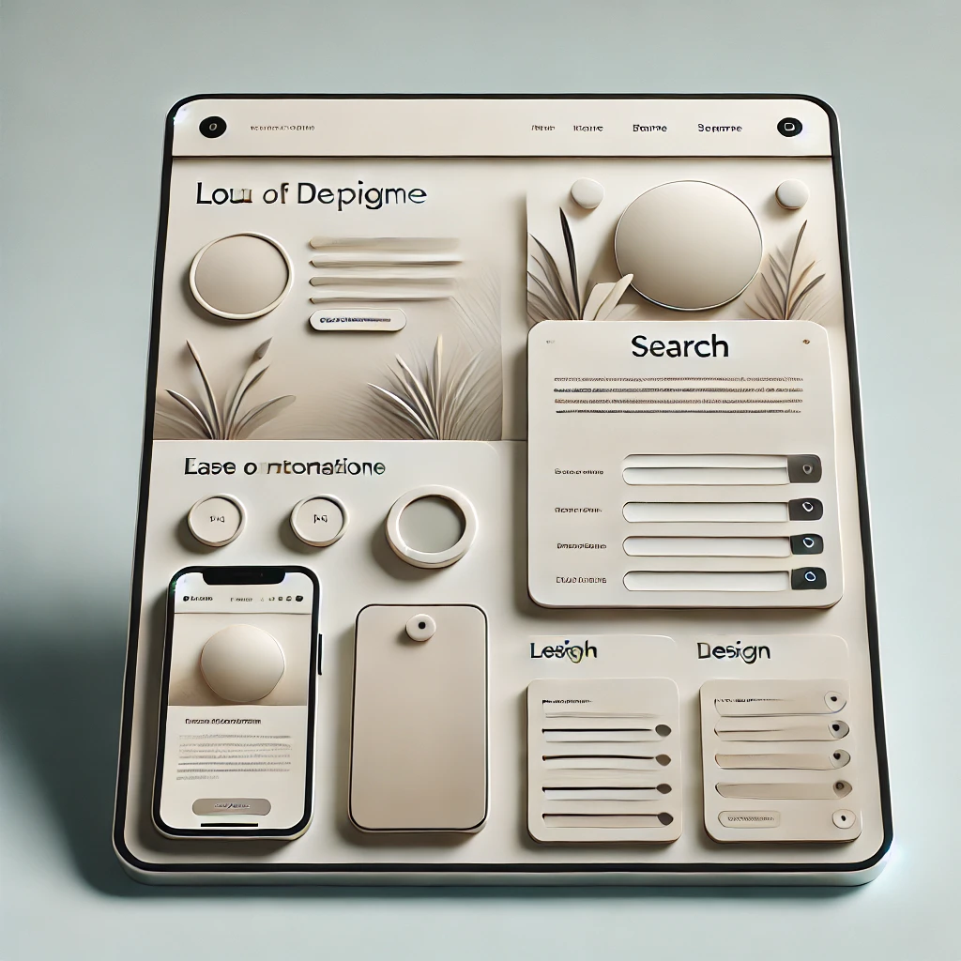
03. Challenges Resolved
3. Challenge: Maintaining Clean and User-Friendly UI/UX.
Issue: Creating a seamless, easy-to-navigate interface for users, particularly for girls interested in IT products.
Solution: Focused on a simple navigation bar and a clean layout with categorized product sections. Applied consistent styling and easy-to-read fonts for a better user experience.

Slide 20
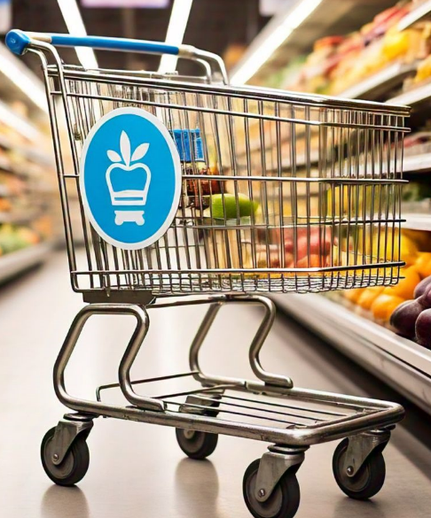
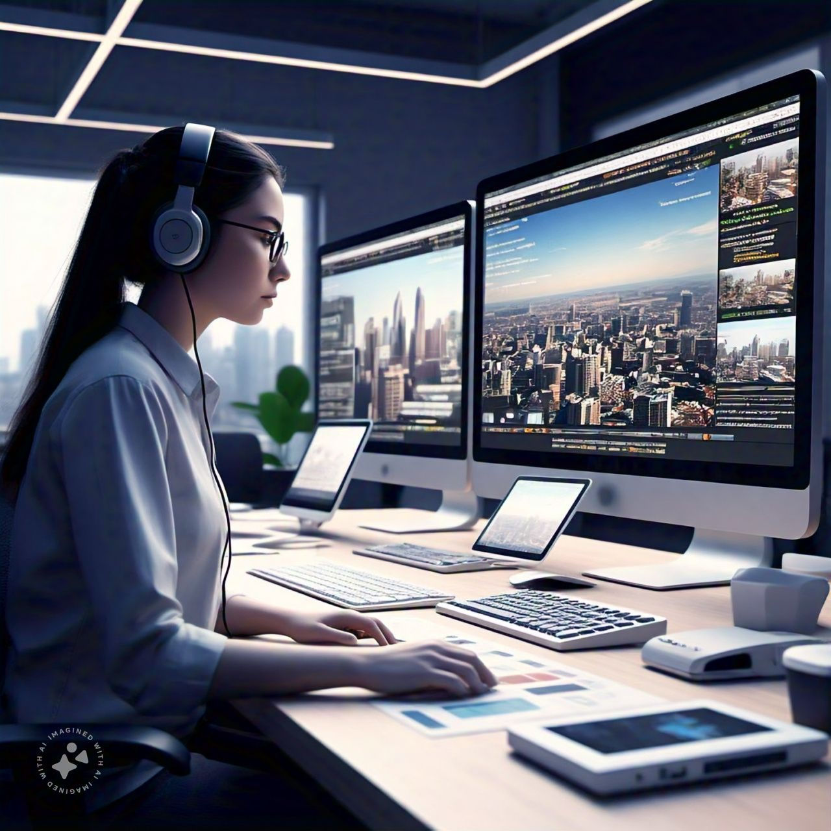
03. Challenges Resolved
4. Challenge: Efficiently Managing Content.
Issue: Handling product data dynamically, like product additions to the cart, without page reloads.
Solution: Used json.queries and going to use React.js further for dynamic content updates, allowing the shopping cart and product info to update in real-time.

Slide 21
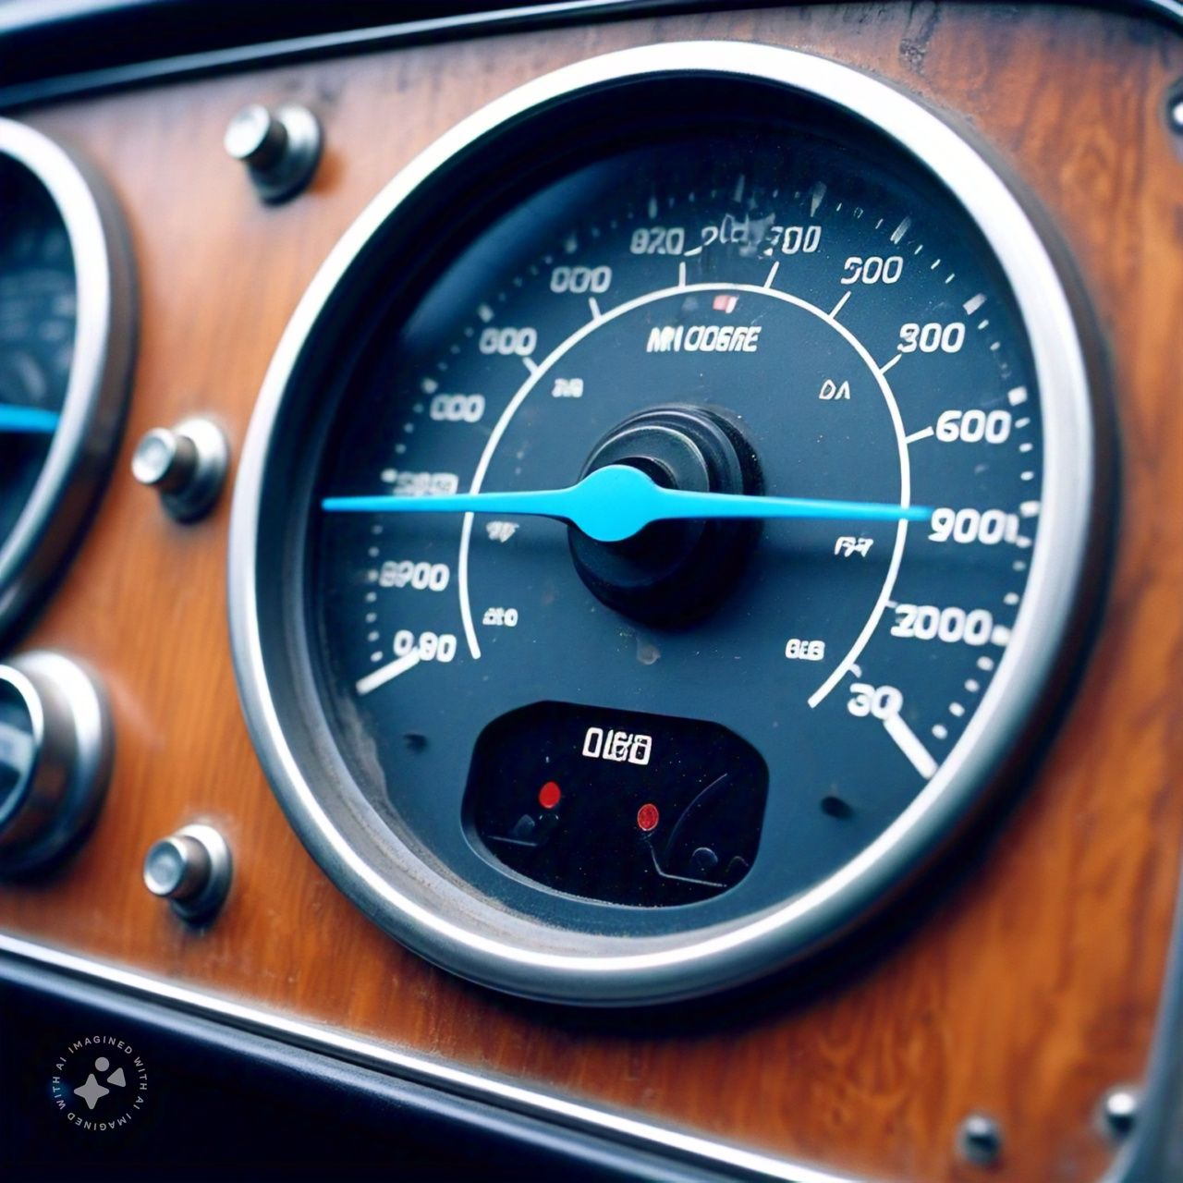
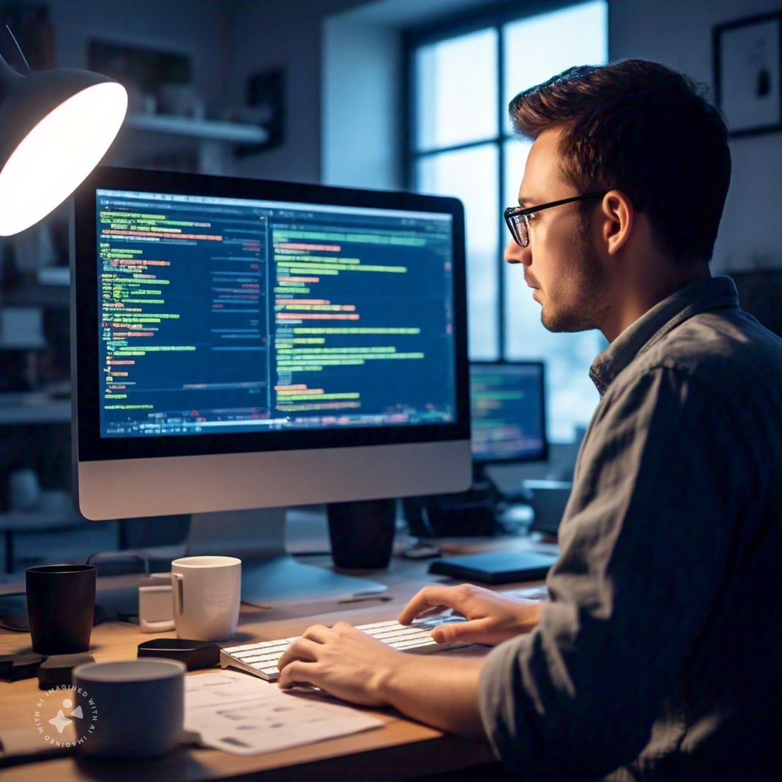
03. Challenges Resolved
5. Challenge: Optimizing Performance and Load Time
Issue: High-quality images slowed down the page load speed.
Solution: Implemented image optimization techniques like compressing images and using the WebP format for faster loading times.

Slide 22
THE END

